Slide 1

Global project Management Challenges
Name Javeria Ilyas
Roll no BSCS-F19-M95
Section ‘B’
Author name:-Adam Alami

Slide 2
Introduction
Globalization is understood as the advancement of the human requirement to interconnect on a global basis. In the past, people have interacted over long distances, mostly through analogue ways.
Global Project Management is either executed with a consolidated process (combine assests of two or more entities into one)or fragmented processes(splitting a process into logically different and smaller model parts).
The aim is to identify the challenges of this project execution style and the critical parameters that influence the execution process.
The development of transportation and communication networks across the globe has rapidly intensified globalization.

Slide 3
Background
The literature defines multiple types of projects:
The “traditional projects” that are characterized by co-located team members.
The distributed projects, where team members are located in various geographic locations.
The “virtual project” that is distributed geographically and involves multiple organizations.
Lanubile et al. (2003) explains that the motives behind the increase of Global Software Development (GSD) are access to specialized labour, cost reduction, and global presence

Slide 4
Year | Author | Method | conclude
2010 | Bronius | The paper reports diversity of project management: single or multiple project manage program and project portfolio management. | The result of this study help us better understand the evolution of project management as a field of practice
2011 | P.D.Rwelamila | While project are recognized as mean to achieve competitive advantages in Africa. Project management still remains a cinderella field. | PM training is falling short of some fundamental knowledge area. These challenges are referred to know as “PM trilogy challenges”.
2012 | Bon-Gang Hwang | This study aims to identify challenges faced by project managers who execute green construction projects and to determine the critical knowledge areas and skills that are necessary to respond to such challenges. | This study will help establish a knowledge base for project managers to be competitive and to effectively execute sustainable projects.

Slide 5
Year | Author | Method | Conclusion
2013 | Roberto Sbragia | The challenge of managing multicultural teams. | Avoid the problems that multi-culturalism can bring, ranging from conflicts between people to project failure.
2014 | S Rokooei | The rules and method required for general project management. | The project management shares the common and overall characteristics of general project.

Slide 6
Method/Analysis
The research investigates global project management with two main players: client and service provider.
Collection of data was through semi-structured interviews with project members and documents examination; that is, meetings minutes and project progress tracking reports.
A “deductive” approach to analyzing the data was employed to identify patterns in the collected data and to draw conclusions.
A detailed assessment of the issues raised using the SDLC (Software Development Life Cycle) stages of project execution are

Slide 7
Method
Semi-structured interviews provided in-depth information about the attainment of global management project.
The information obtained from both semi-structured interviews with project members and documents examination is highly qualitative in nature
Requirement
Design
Development
Testing

Slide 8
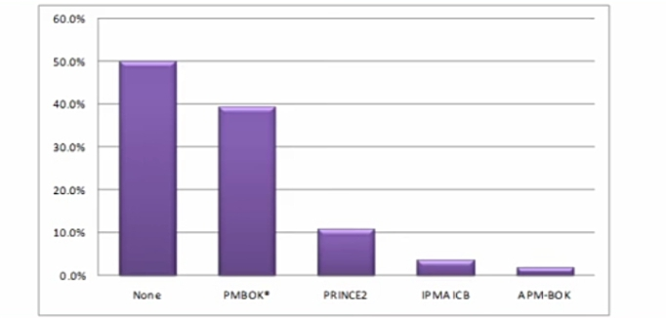

Slide 9
Discussion
The client and the service provider had different project execution approaches.
This case study revealed some challenges that negatively impacted the execution of the global project.
Organization culture, communication, coordination, and power had direct consequences on execution of the project.
The biggest challenges in GPM are:
Lack of effective communication As project manager expected to spend 75 to 90% of your time to communicating with your project team members.
Scope creep(feature creep) continuous and uncontrolled growth in a project’s scope.

Slide 10
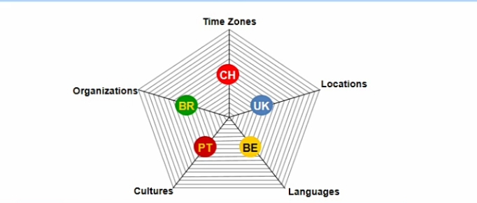
Discussion
Organizational culture:-
It explains that culture shapes
the way individuals think,
their inspirations, and
their choice.
Power and relationships:-
Trust is critical to outsourcing relationships’
success suggest that when trust is established
, communication, performance, deliverables,
and greater satisfaction in the decision-making
process occur.

Slide 11
Future work
The focus of the future research should look at how global projects can be managed as well as how to overcome the issues identified in this research.

Slide 12


